Slide 1
SCUM UPDATE3
ROS2 Object Detection and Tracking in field Autonomous Vehicles

Slide 2
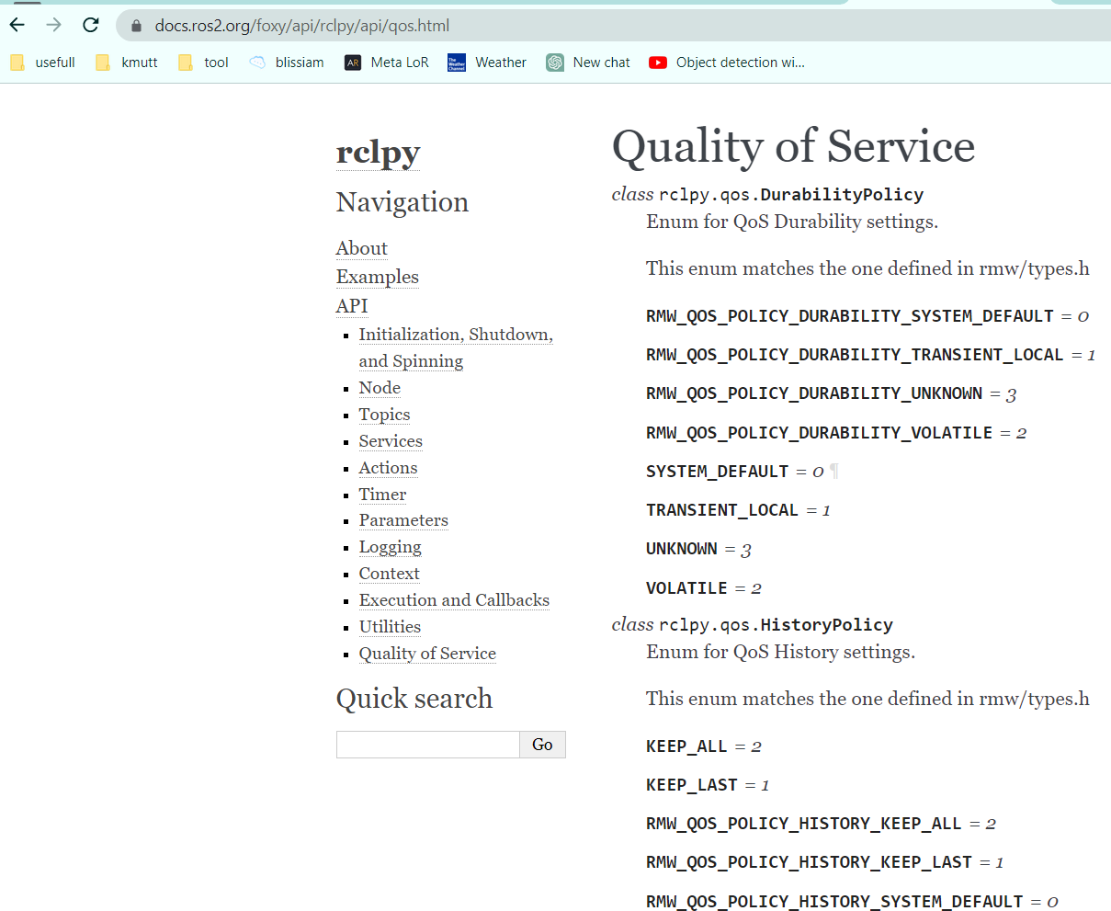
QOS
https://docs.ros2.org/foxy/api/rclpy/api/qos.html

Slide 3
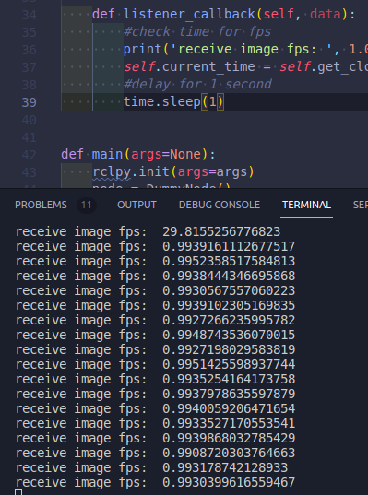
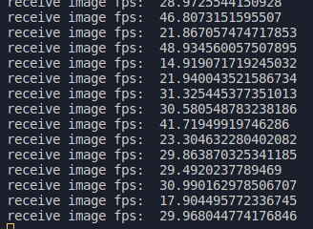
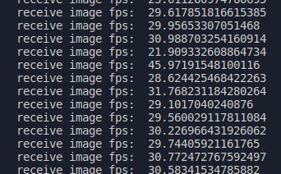
QOS

Slide 4
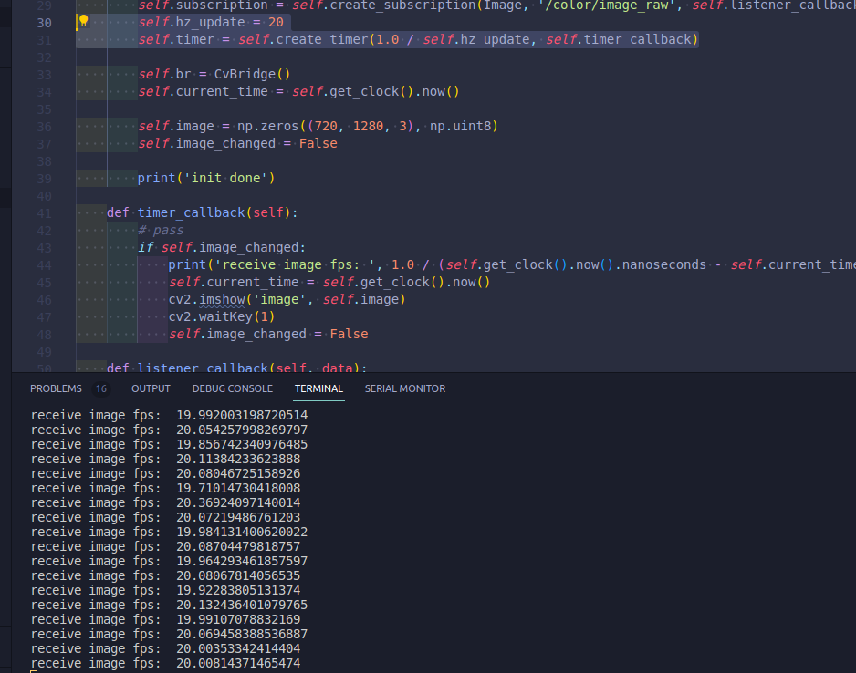

Slide 5
